Slide 1

IBM SPSS MODELER ANALYSIS
Loan Eligibility Prediction
A Classification Model Analysis
Sambhav Pandey
BBA Business Analytics
Sectoral Functional Analytics
ROLL NO: 1240645166
SECTION: BBA BA32

Slide 2




Project Introduction
Main Goal
Methodology
The Output
Assess preliminary bank loan applications for approval or rejection.
Uncover financial and demographic patterns in previous applications.
Classification model predicting Loan_Status as 'Y' or 'N'.

Slide 3
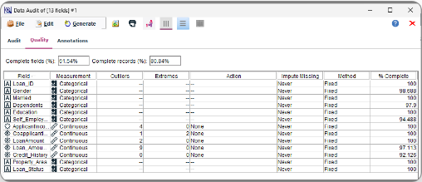
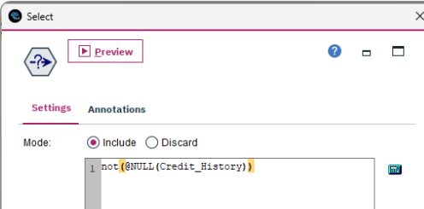
Data Used & Preparation
Dataset
13 fields of applicant details and financial metrics.
Data Audit
Missing values detected in Credit_History and Self_Employed.
Data Cleaning
Filtered incomplete records using Select node.
not(@NULL(Credit_History))

Slide 4
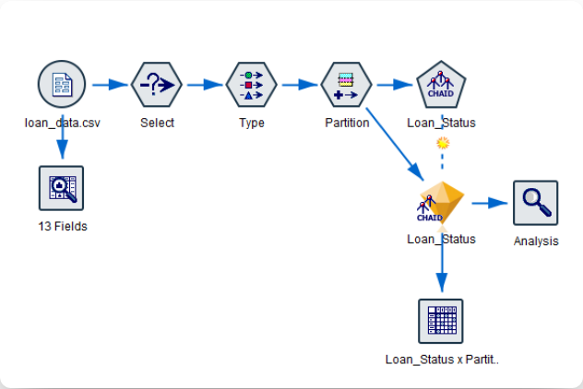
Project Workflow
1
Import data via Var. File.
2
Clean missing values.
3
Define Target status.
4
Split data partitions.
5
Train classification model.
6
Evaluate via Analysis nodes.

Slide 5
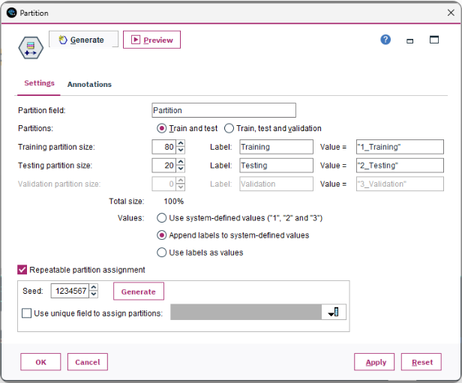
Data Partitioning
80%
Training Set
268 records teach underlying applicant patterns.
20%
Testing Set
83 records evaluate predictive accuracy.

Slide 6
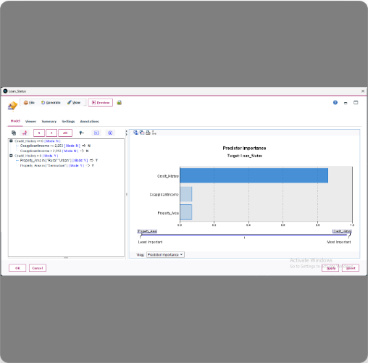
Model Used: CHAID Decision Tree
Algorithm
Builds decision rules using Chi-squared Automatic Interaction Detection.
Key Driver
Credit_History identified as the primary predictor.
Secondary Factors
CoapplicantIncome and Property_Area influence the final decision.

Slide 7
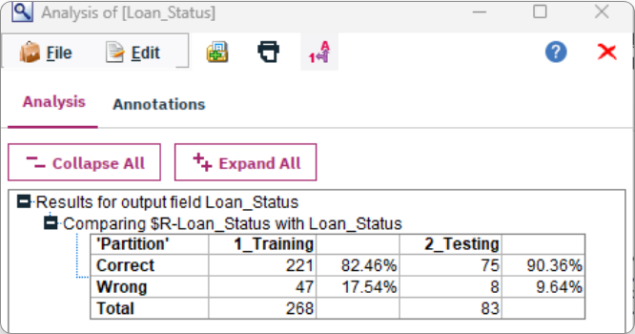
Results and Accuracy
TRAINING PERFORMANCE
82.46%
221 correct out of 268
TESTING PERFORMANCE
90.36%
75 correct out of 83
ERROR RATE
9.64%
Only 8 incorrect predictions

Slide 8
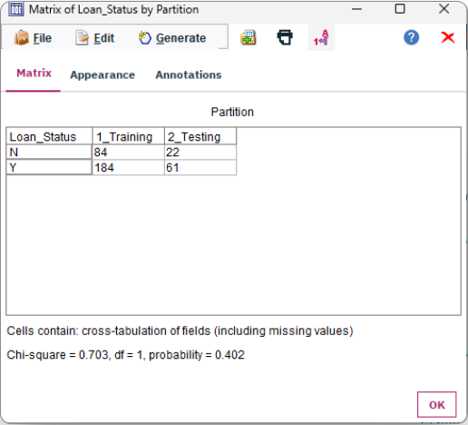
Confusion Matrix & Conclusion
Test Set Breakdown
Matrix confirms precise performance across both target classes ('Y' and 'N').
Conclusion
CHAID workflow generates highly accurate loan eligibility predictions.
Future Application
Deployable to fast-track reliable applications, supporting human financial judgment.

